Slide 1
Increasing Students’ participation
Nataliia Nechai
Department of Foreign Languages
NMU

Slide 2
Small groups
Making decisions
Background knowledge
Step-by-step progress

Slide 3
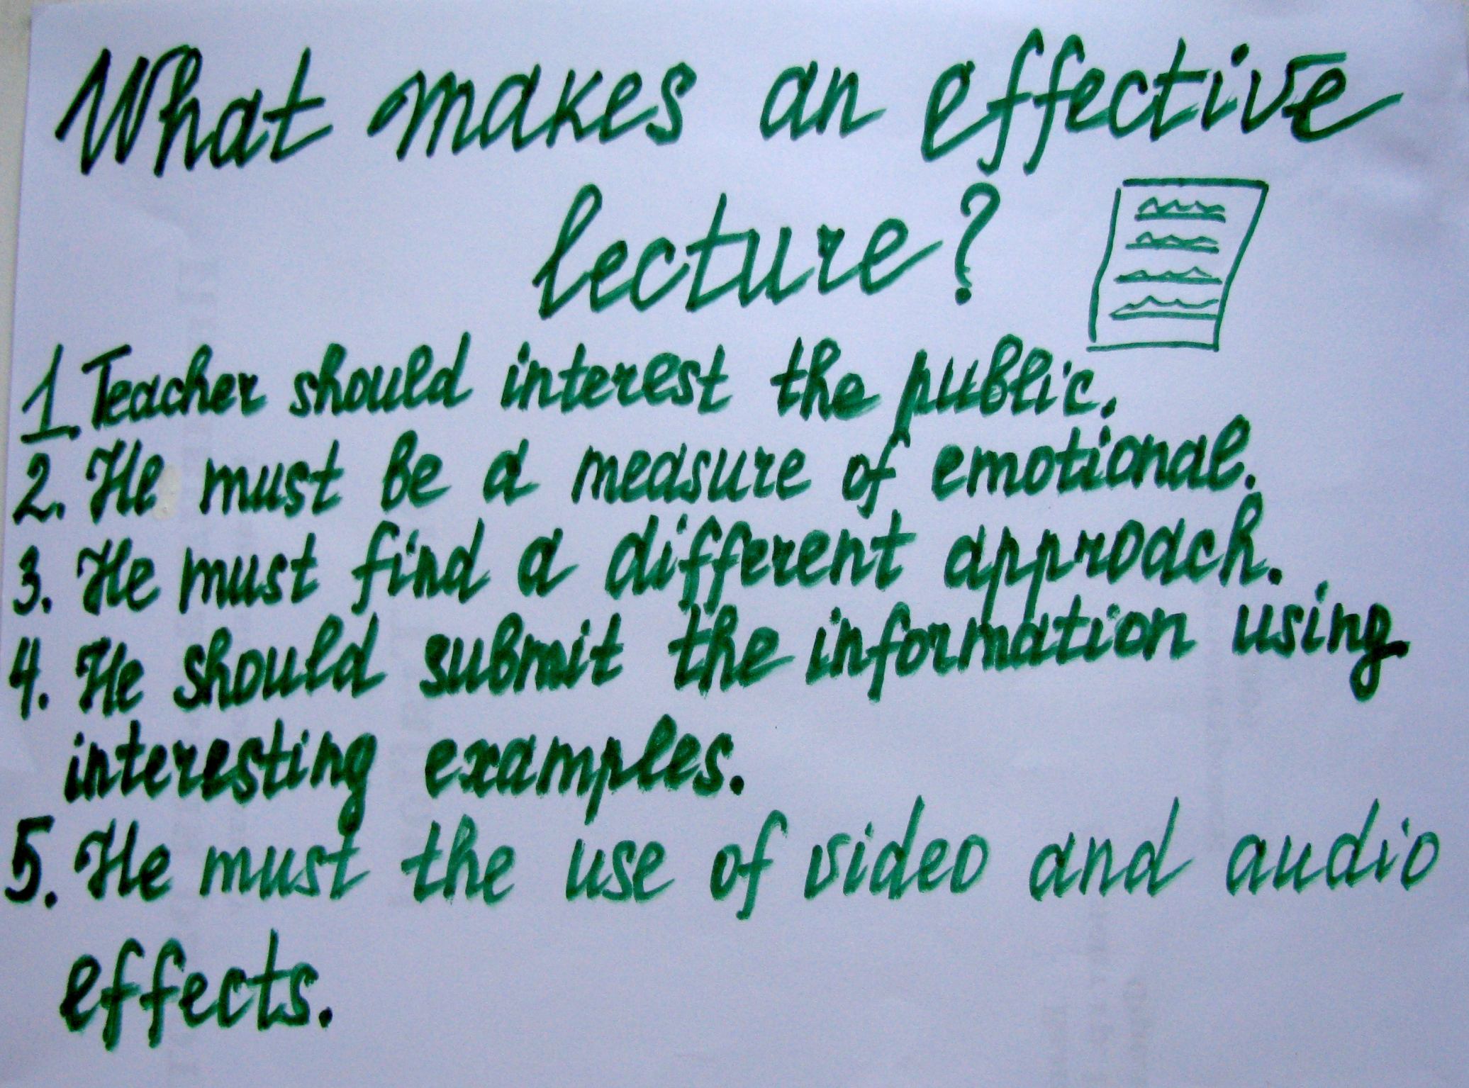

Slide 4
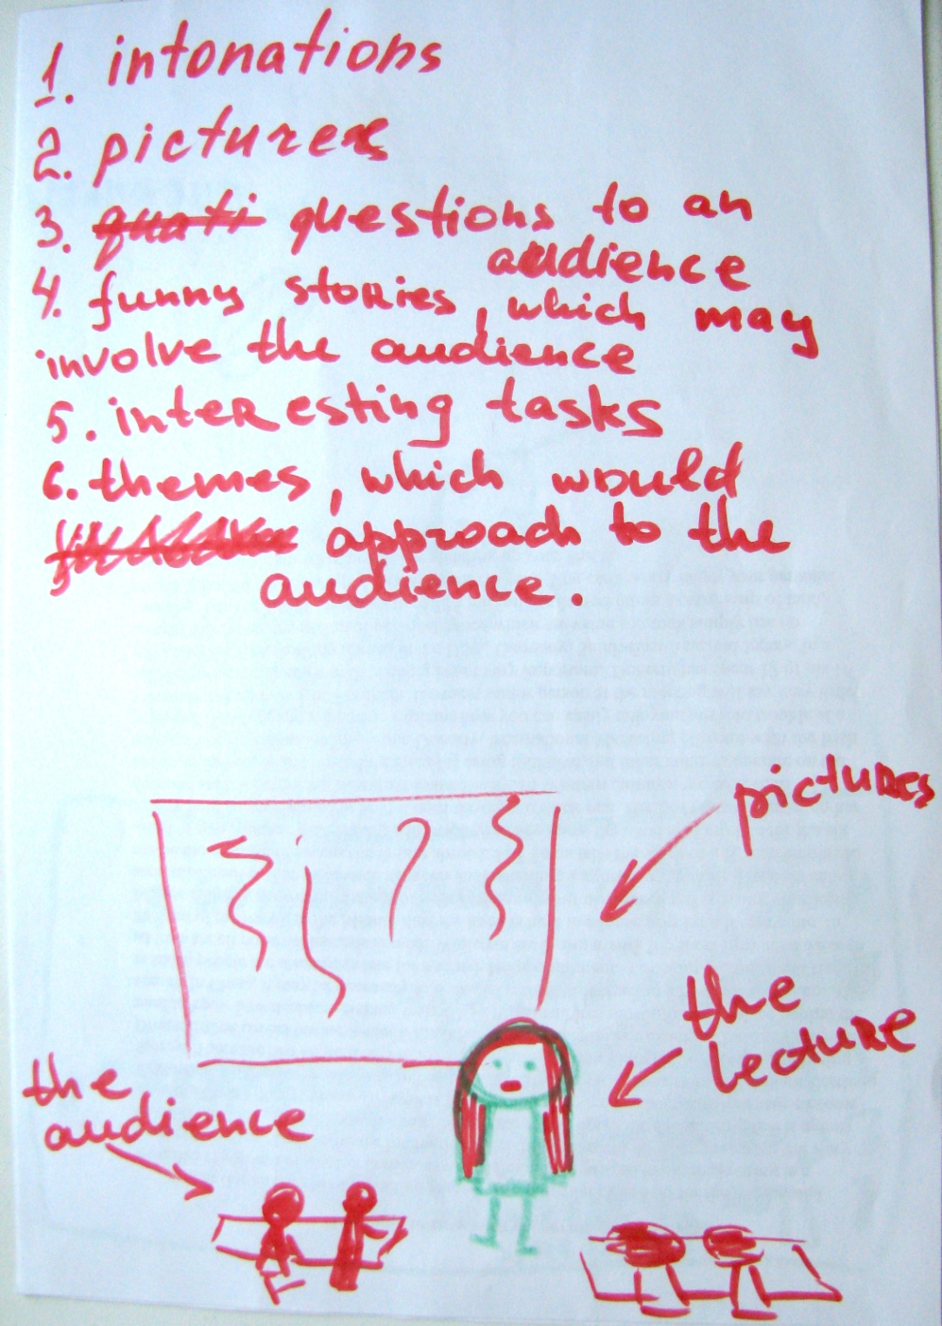
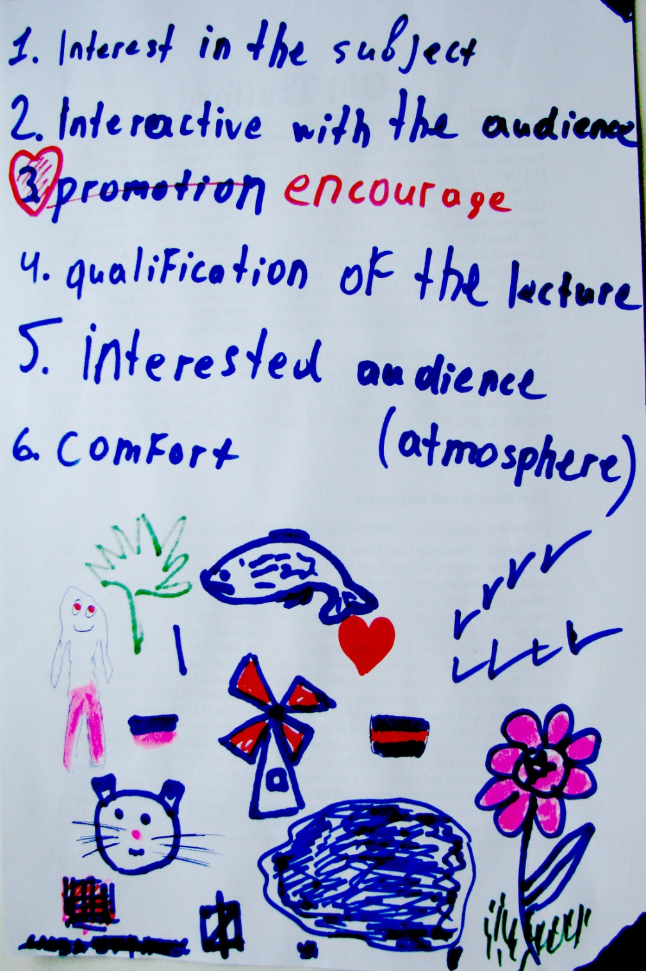

Slide 5
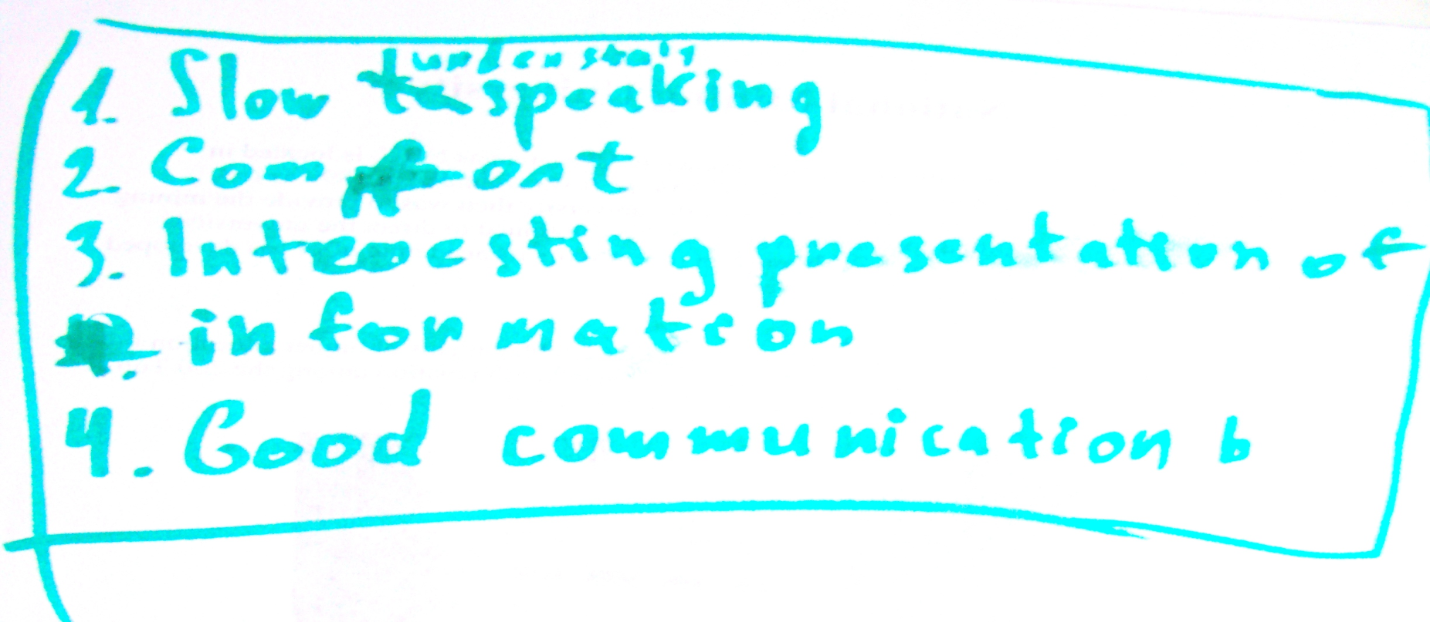
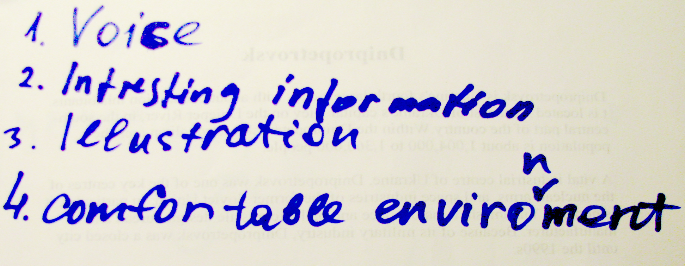

Slide 6
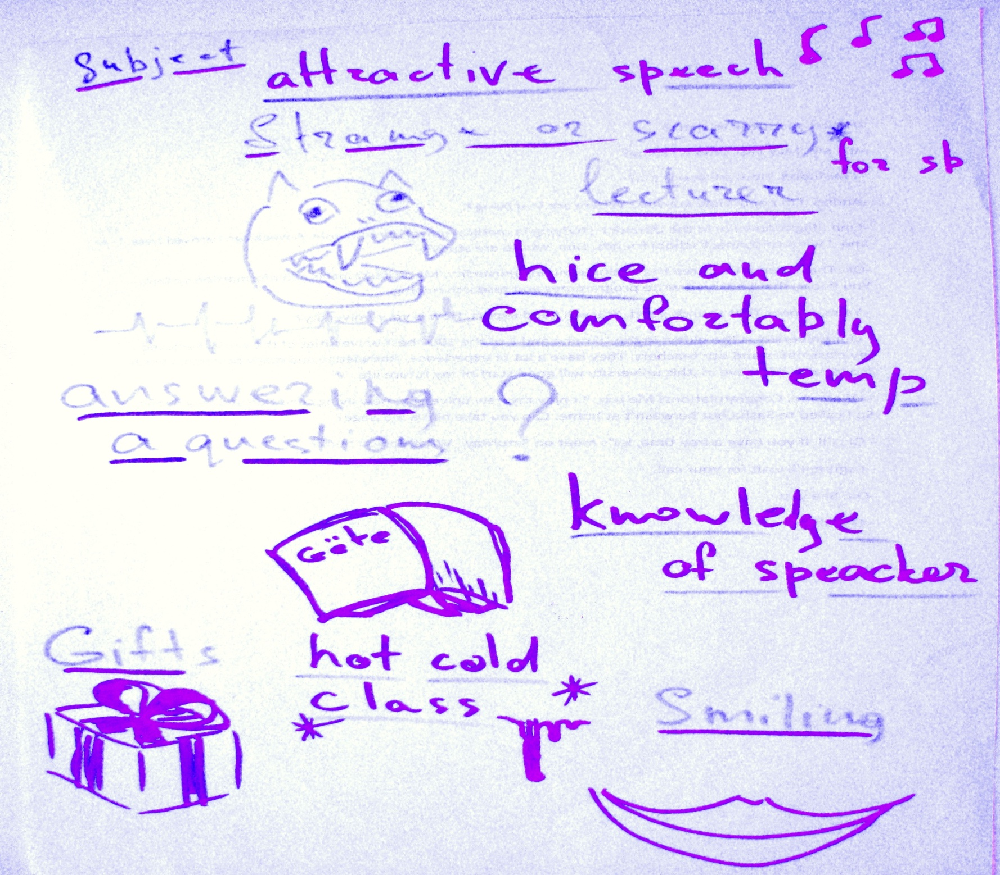

Slide 7
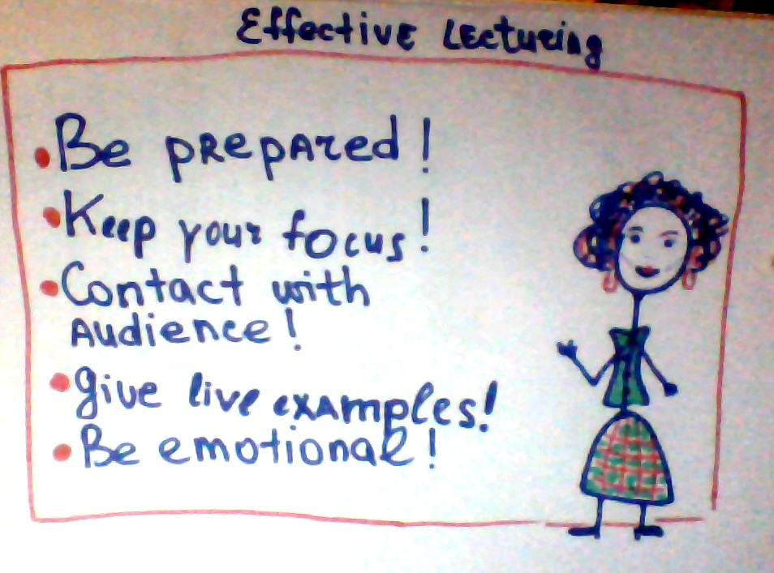

Slide 8
Illustrations + video
Interaction (answering questions)
Giving examples from real life
Interest in the subject
Qualification
Intonation and tempo of speech
Emotions \ smile
Comfort (temperature)
Attractive appearance
Being strange or scary

Slide 9
Thank you for your attention

